Slide 1
Poster and Talk Requirements
LANL only; Unclassified
Notes:
There are pictures of badges in this talk. Please do not distribute outside of LANL.

Slide 2
Summary
Poster Requirements
Talk Requirements
Supercomputing 2014 Poster Submission

Slide 3
Poster Requirements

Slide 4
Poster Session
Many people from the lab will be there
other students
mentors
lower/middle/upper management
Stand near your poster
at least one person at all times during poster session hours
Gets crowded
so no anchovies for lunch!
Talk about your project
try to make it sound interesting ;-)

Slide 5
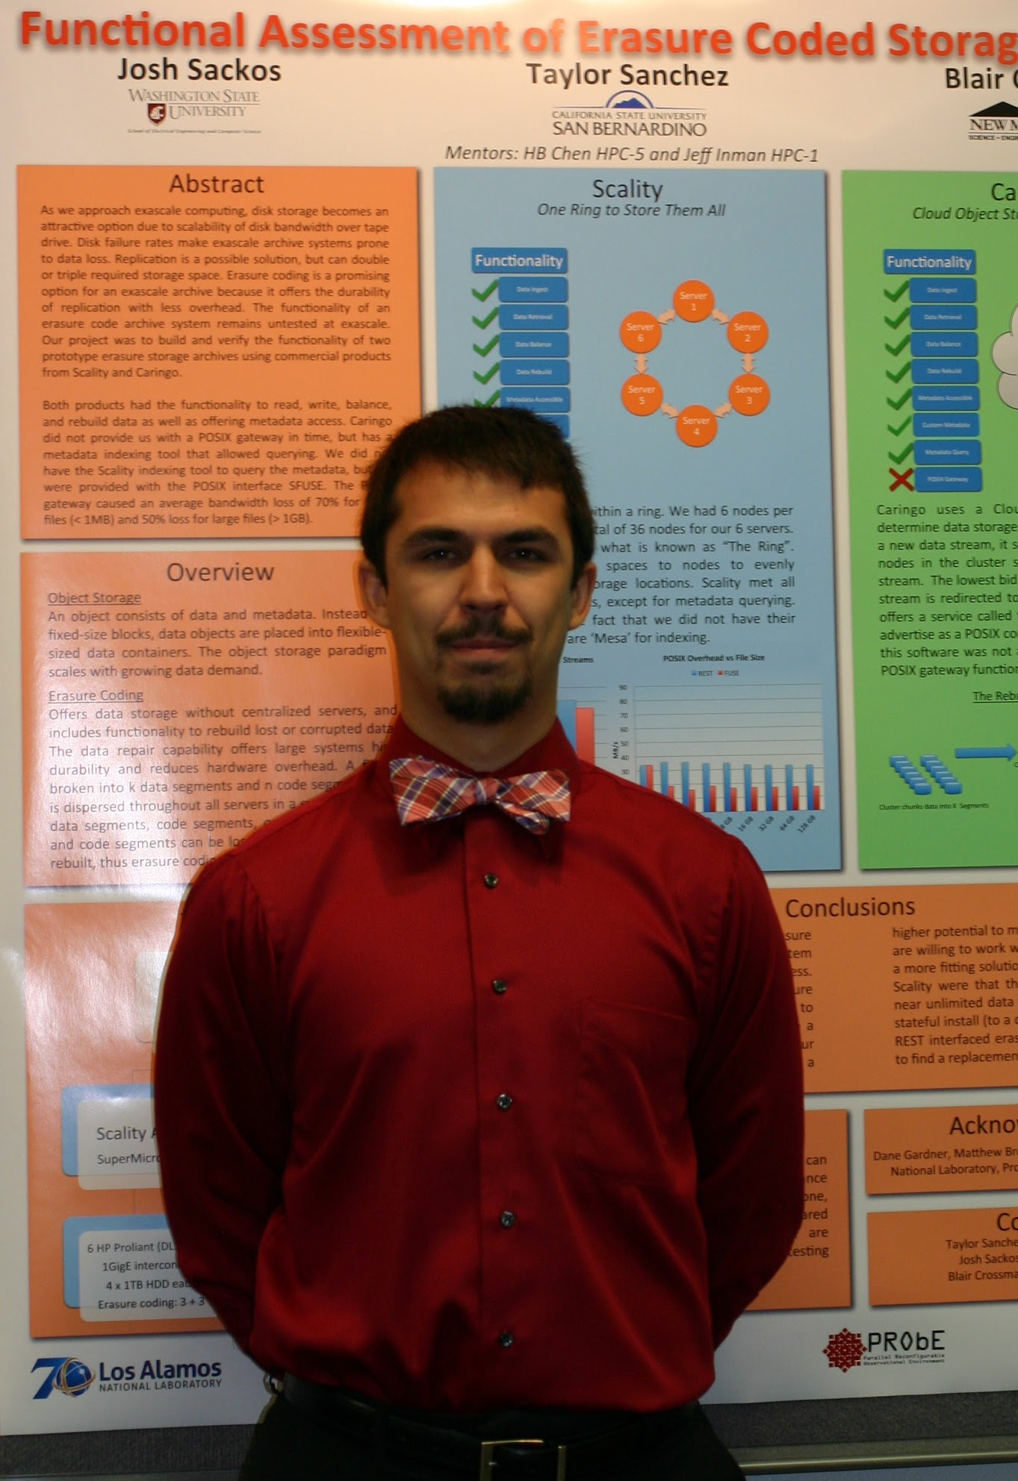
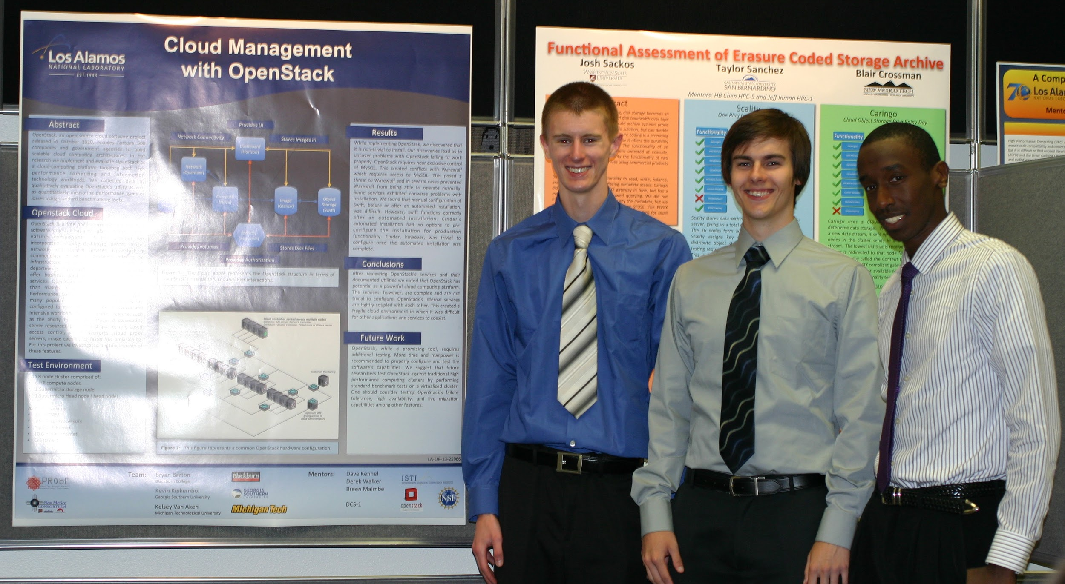
Dress Appropriately

Slide 6
Poster Requirements
45” wide by 35” high
~24pt
min 18pt font
legible from at least 3-feet
Submit in
PowerPoint for printing
PDF for LA-UR and archive
Title
Sections:
Abstract
Research process or methods
Results
Conclusion(s)
Future work [optional]
Logos
Mentor names

Slide 7
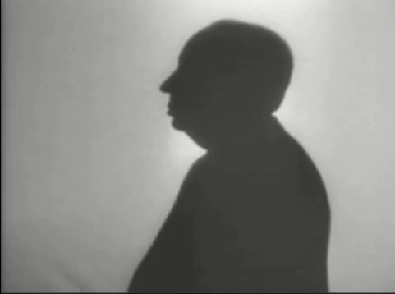
What is drama but life with the dull bits cut out.
-Alfred Hitchcock

Slide 8
Abstract
Describe the problem or opportunity
Describe your hypothesis
Summarize your testing approach
don’t get too specific, yet
Summarize your results
just enough to wet their appetite!

Slide 9
Research Process or Methods
What steps did you take to test your hypothesis?
Be specific about your platform
what hardware? model numbers; quantity; configuration
what software? versions; custom compiled; configuration
But be selective
don’t discuss something that’s inconsequential
skip the stuff that everybody in our field already knows
but be prepared to answer questions
What problems did you run into?
did they affect your results or conclusions?

Slide 10
Results and Conclusion
Again, be specific
always use units!
Again, be selective
don’t discuss things that don’t matter
but (again) be prepared to answer questions
Graphics
can display a lot of information in a small area
can illustrate what you’re saying in your text

Slide 11
Protip: Colors
Be aware that what you see on the screen is not what will be printed out
colors that appear to be well contrasted might merge into one blob!
High contrasting complementary colors
http://en.wikipedia.org/wiki/Color_wheel
http://paletton.com/

Slide 12
Logos
Part of a brand, or image the entity is trying to convey to the public
As such, usually has rules associated with usage
permissions
size and prominence
ratio restrictions
background colors
Research usage guidelines for each institution before using their logo!
LANL, NMC, your schools, etc.

Slide 13





Required Logos

Slide 14
Logos - Squished; don’t do it

Slide 15
Logos - Squished; don’t do it

Slide 16
Logos - Uniformity

Slide 17
Logos - non-Uniformity; don’t do it
AKA “Logo Soup”

Slide 18
Logos - non-Uniformity; don’t do it
AKA “Logo Soup”

Slide 19
Poster Steps
Create poster draft
Verify that it meets specifications
Send draft to Instructor for review
If things need fixing
fix things, then go to step 2
Send draft to Mentors for review
If things need fixing
fix things, then go to step 2
Send final draft (PDF) for LA-UR to Josephine
Update poster w/ LA-UR
Send final draft (PDF & PPTX) w/ LA-UR to Josephine and Instructor

Slide 20
Resources
Our wiki has logos and other documentation
Mini showcase student instructions website:
http://int.lanl.gov/science/people-partnerships/national-security-education-center/information-science-technology-institute/mini-showcase/index.shtml
CSCNSI public website has past posters and talks:
http://institute.lanl.gov/isti/summer-school/
Posters on wall in server room
Instructor, TA, Mentors, and Josephine

Slide 21
Talk Requirements

Slide 22
Technical Talks
Usually good attendance
other students
mentors
HPC (et al.) management
Every person will talk for allotted time
Lots of pictures and visualizations, where possible
Scott Robins will work with you on a lot of this stuff, and then we’ll practice, practice, practice!

Slide 23
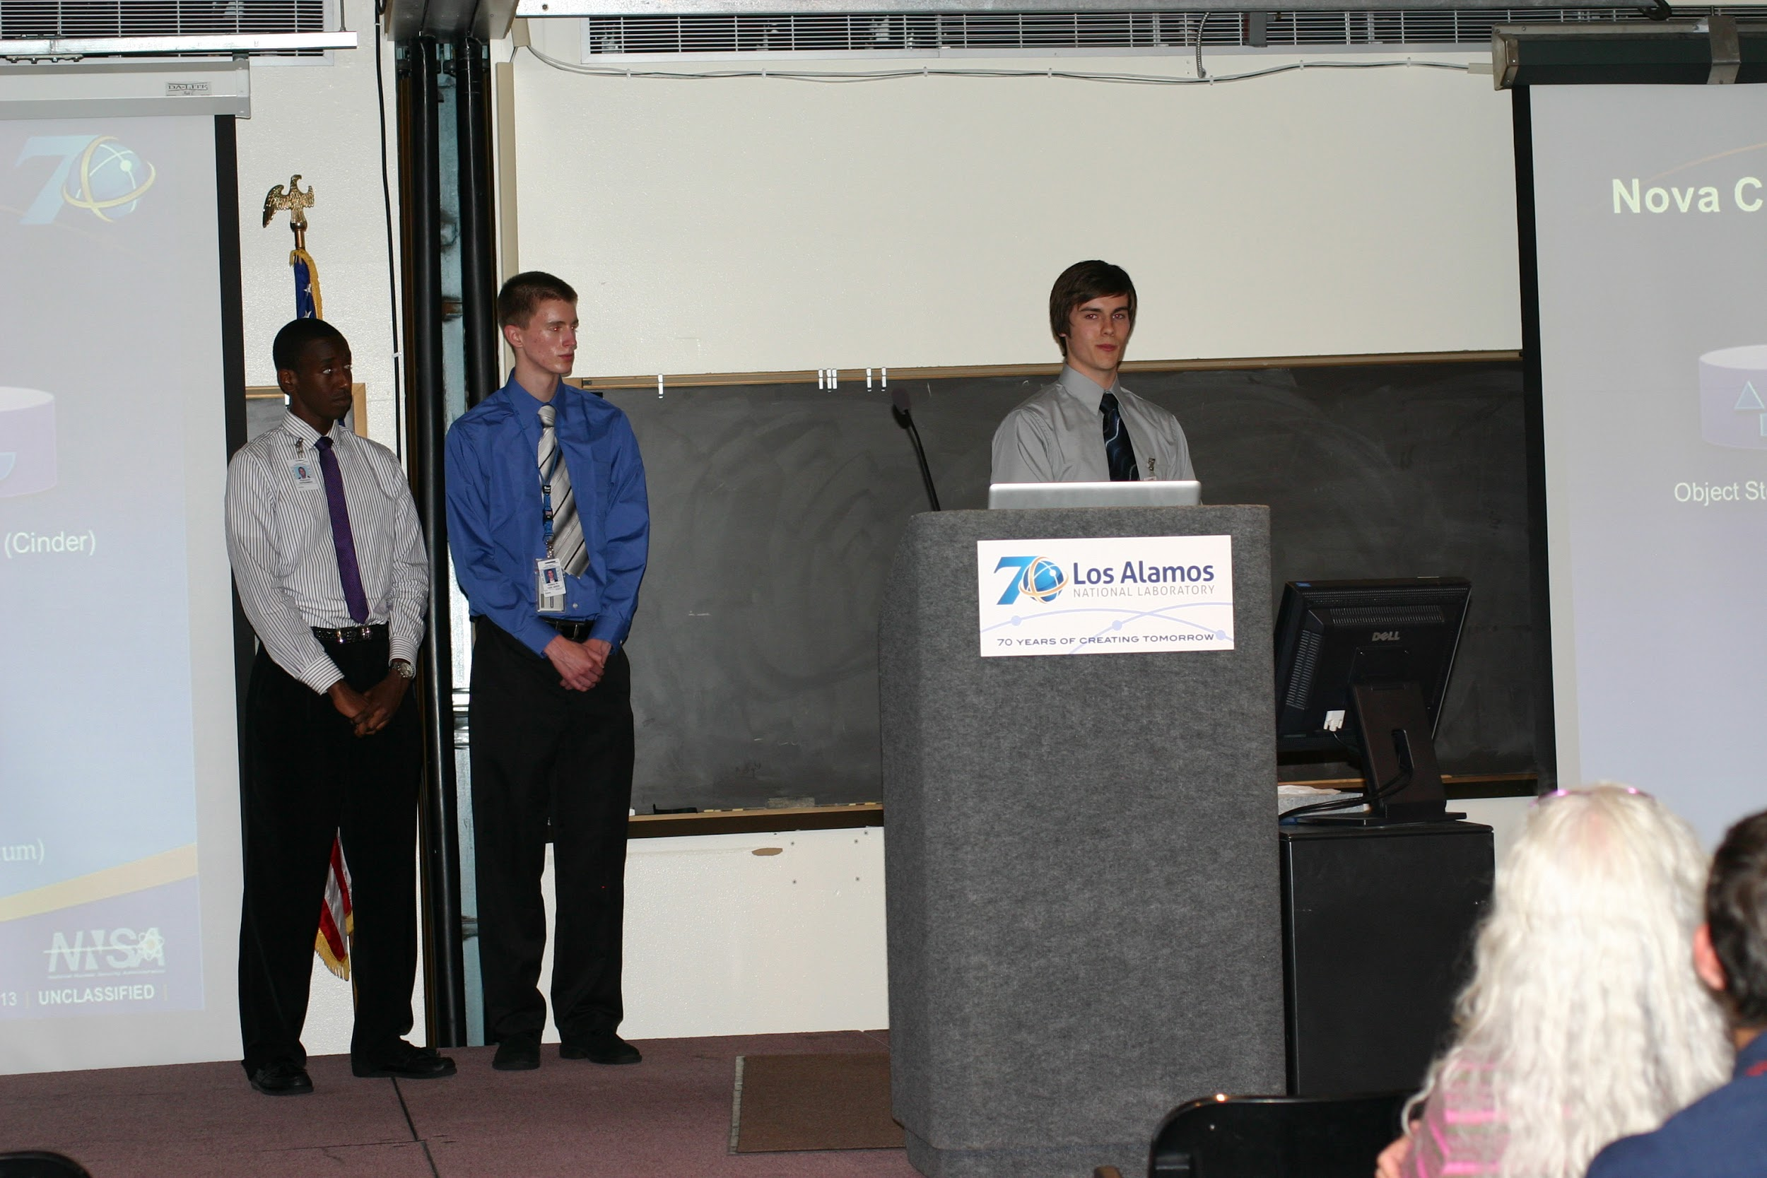
LANL only; Unclassified
Notes:
LANL only: badges in picture

Slide 24
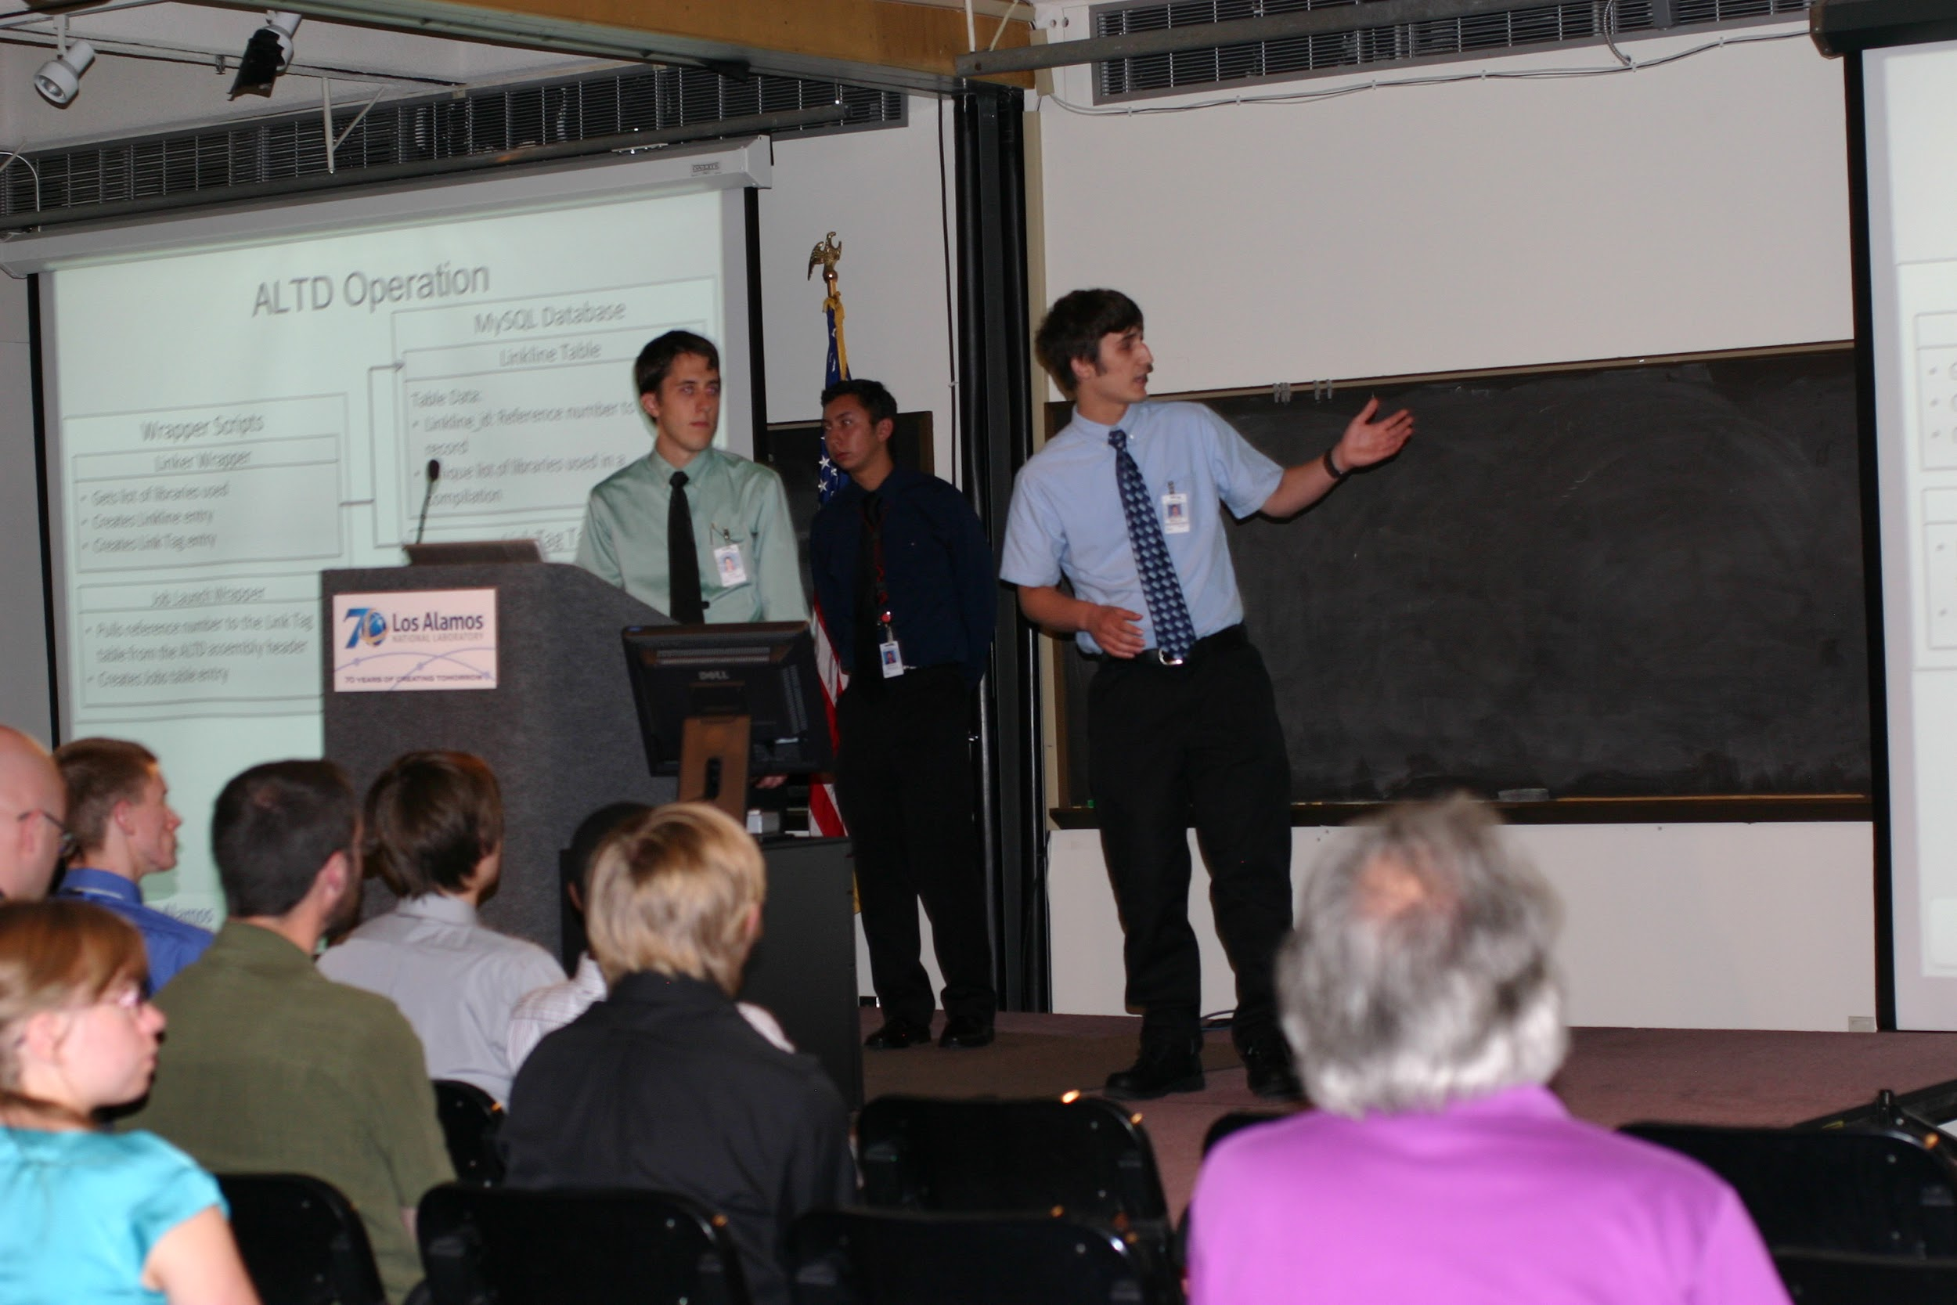
LANL only; Unclassified
Notes:
LANL only: badges in picture

Slide 25
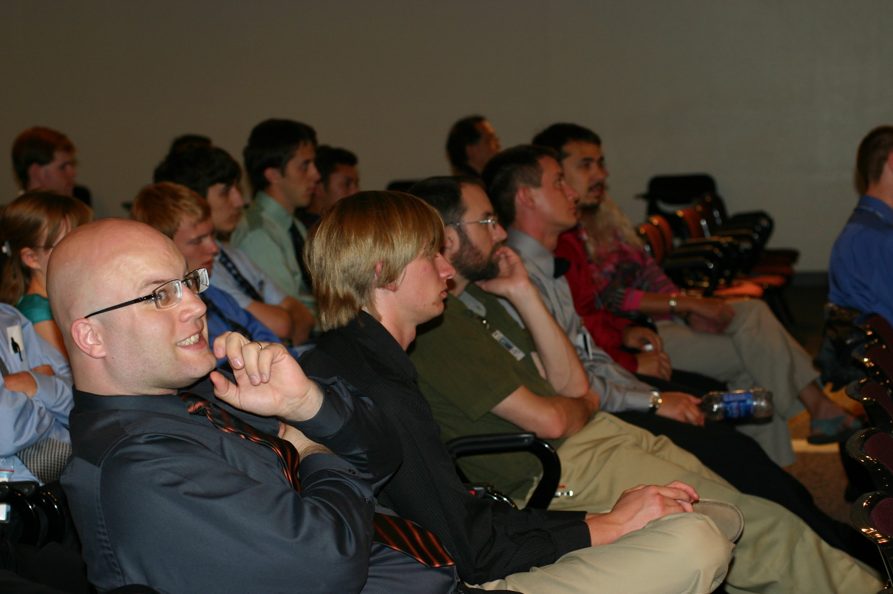
LANL only; Unclassified
Notes:
LANL only: badges in picture

Slide 26
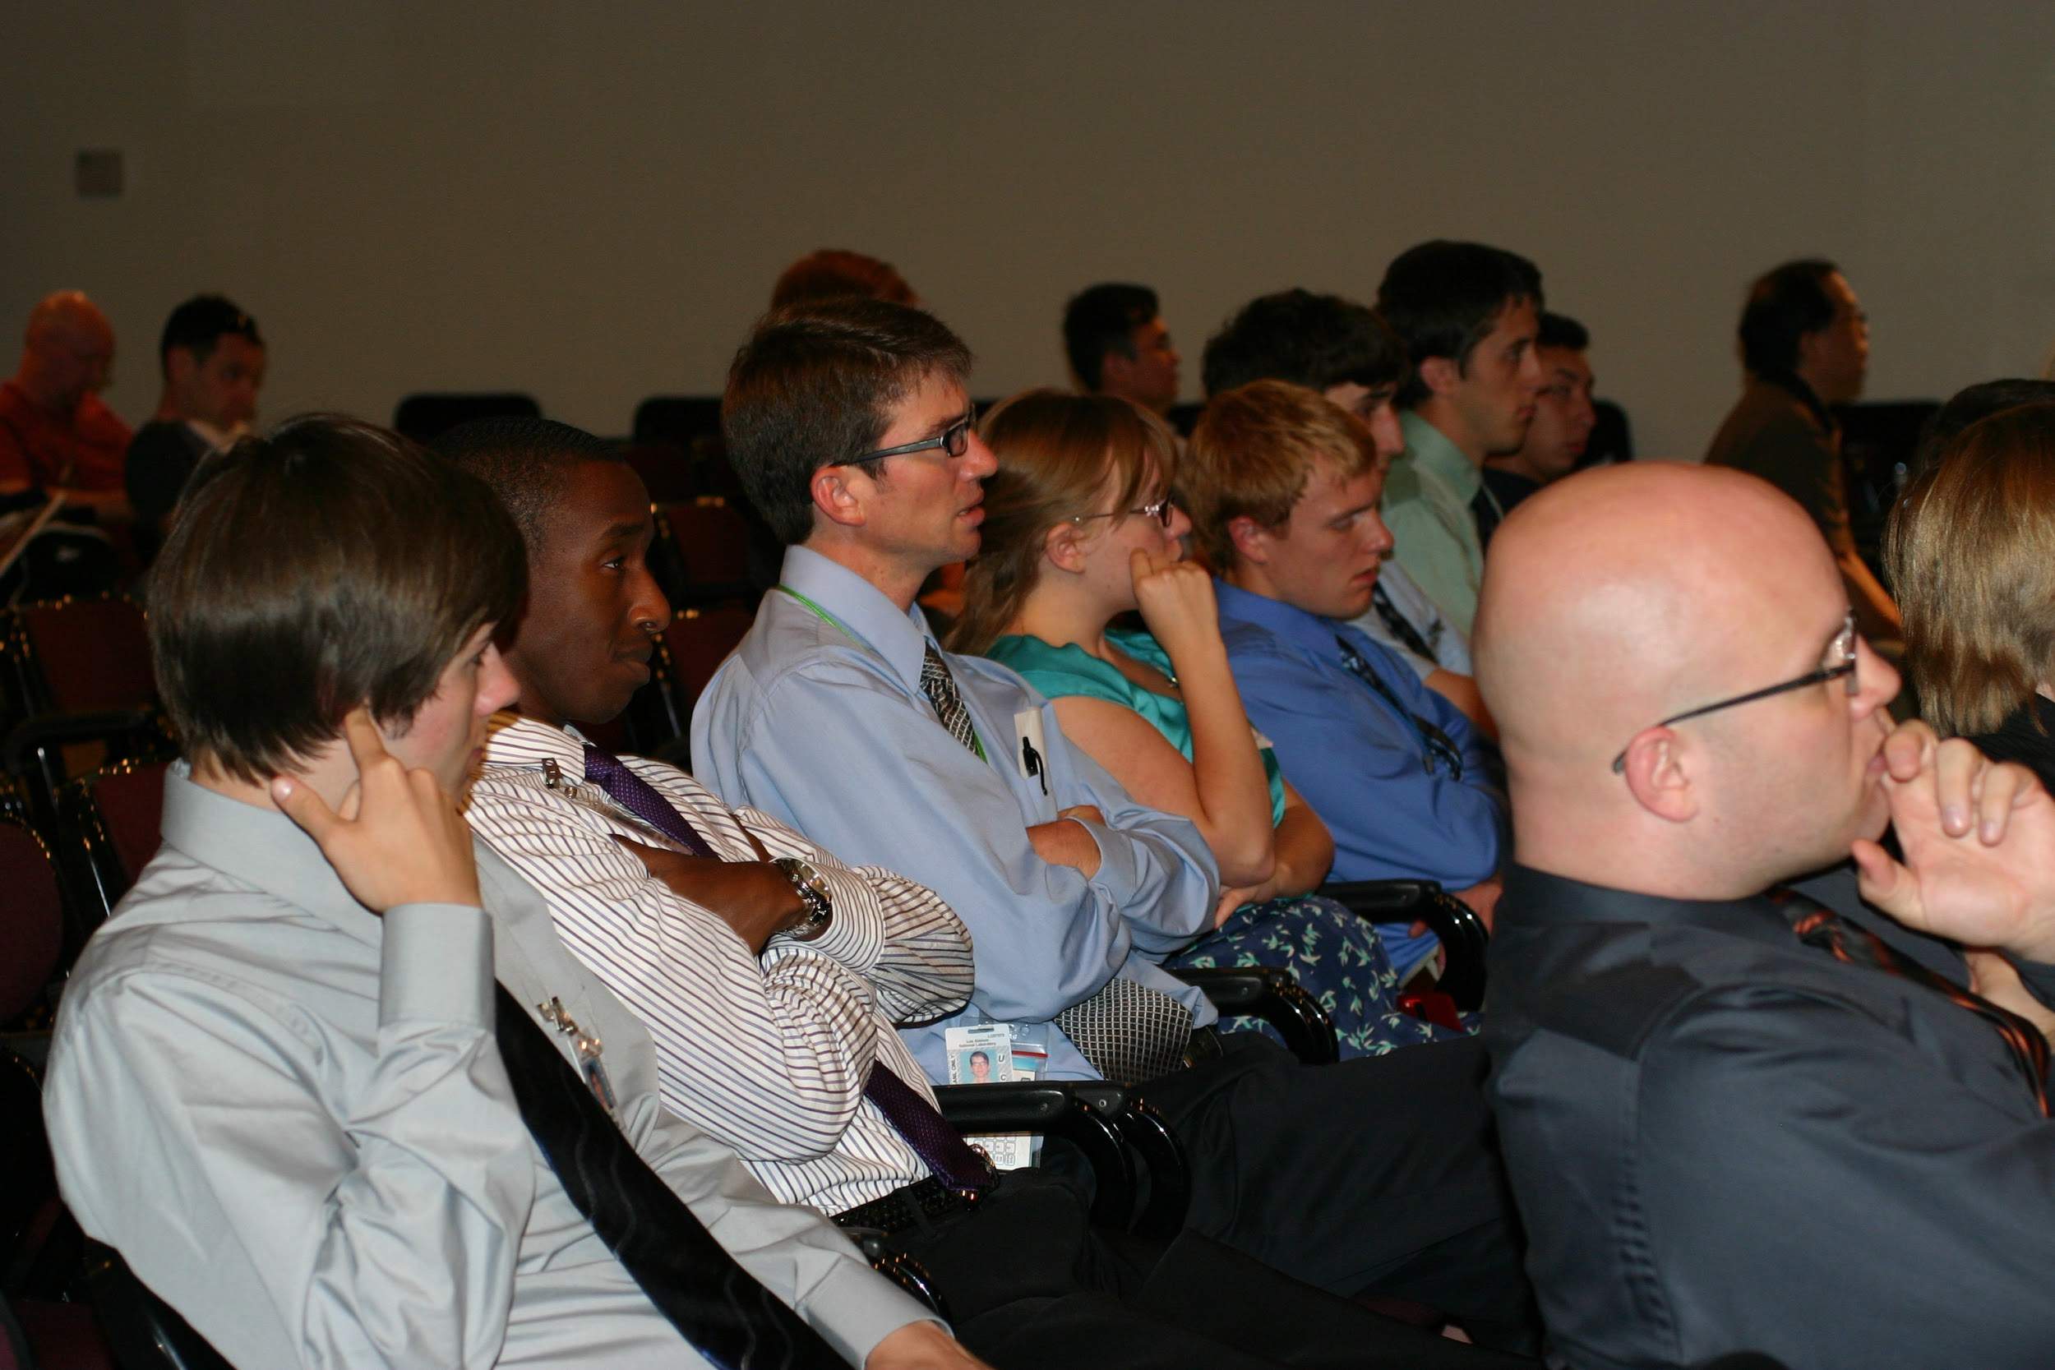
LANL only; Unclassified
Notes:
LANL only: badges in picture

Slide 27
Talk Requirements
Not widescreen!
Include title page
with your names
mentor names
logos
LANL template
Timed
10-15m per group;
divided evenly
Time for questions
Everybody must speak!

Slide 28
Technical Talks
Tell them what you’re going to tell them
Tell them
Tell them what you told them
Answer questions

Slide 29

November 17-20, 2014

Slide 30

Supercomputing
MUST HAVE LA-UR ON YOUR
POSTER BEFORE SUBMITTING!

Slide 31
Supercomputing
MUST HAVE LA-UR BEFORE SUBMITTING!
Submit as ‘regular’ poster
‘education’ posters are on how to teach HPC, not those learning it!
Find your category and select your keywords
PROTIP: write your abstract and poster to these, not the other way around!
Two abstracts
short (≤ 150 words)
extended
Poster size (≤ 8’ wide by 4’ tall)
Notes:
http://sc14.supercomputing.org/program/posters
http://sc14.supercomputing.org/program/posters/poster-fqa
https://submissions.supercomputing.org/?page=SampleForms

Slide 32
Supercomputing
Submit a draft by July 31, 2014
http://sc14.supercomputing.org/program/posters
http://sc14.supercomputing.org/program/posters/poster-fqa
Use the sample submit form for further instructions and specifications
https://submissions.supercomputing.org/?page=SampleForms
If you make changes to the poster between submitting and attending SC14, you must update your LA-UR!
Notes:
http://sc14.supercomputing.org/program/posters
http://sc14.supercomputing.org/program/posters/poster-fqa
https://submissions.supercomputing.org/?page=SampleForms

Slide 33
Summary
Poster Requirements
Talk Requirements
Supercomputing 2014 Poster Submission

Slide 34
Questions?

